Slide 1

Shareathon 2019
DXC DIGITAL EXPLORER SHAREATHON 2019
Digital Knowledge: Market Trends, Client Insights, Solutions

Slide 2
Aim
Foster global industry teams and communities
Capture key trends across all key industry segments (4-5 new/validated trends per industry)
Analyse our client’s digital challenges
Capture key industry showcase solutions (2-3 solutions per industry)
Publish and share across DXC

Slide 3
How
Leverage the DXC Digital Explorer Platform
Regional CTO’s to name 1 CT for each industry Teams select 1 or more sub industries from the parent industry
Teams select a captain Captains responsible to drive and co-ordinate the team over the 4 sprints (Scrum master)
4 short sprints – 1 week per sprint (Nov 4th ~ Nov 29th)
Teams can reach out across all DXC org to enrol others

Slide 4
DXC Digital Explorer Shareathon 2019
Sprint 1: Digital Trends
Review and confirm the leading trends/disruptors
Industry Trends are modelled against the DXC Industry Business Value Frameworks
Industry > Sub-Industry > Business Area > Trend Use Case
Sprint 2: Client Insights
Create a workspace in your assigned group for your clients
Investor reports, Strategic papers, latest RFP
Recommendation : Complete the Digital Explorer Yellow Belt Training
Sprint 3: Solutions
Discuss and Review the showcase solutions to be added
Add the solution into Digital Explorer
Sprint 4: Playbooks
Discuss and Review the showcase solutions to be added
Add the solution into Digital Explorer

Slide 5

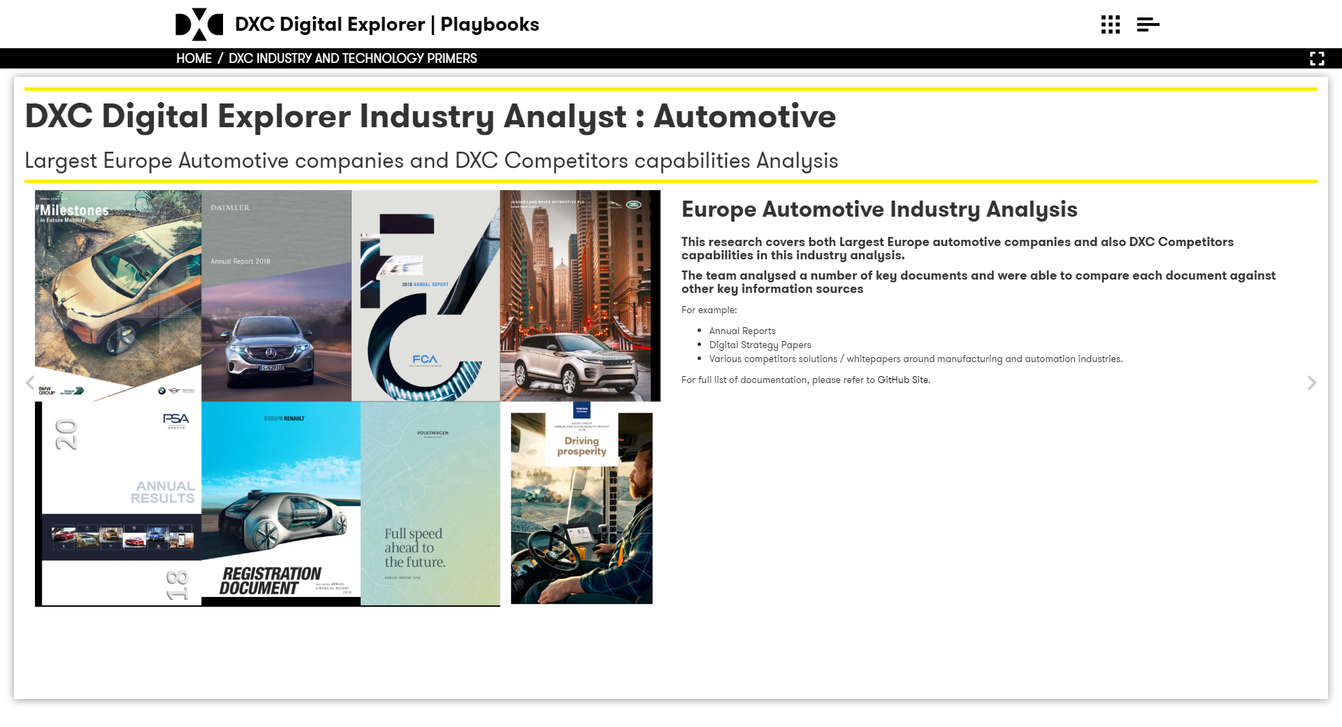
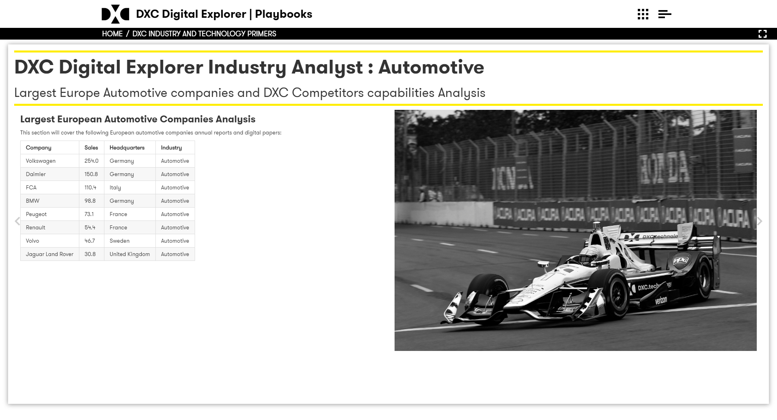
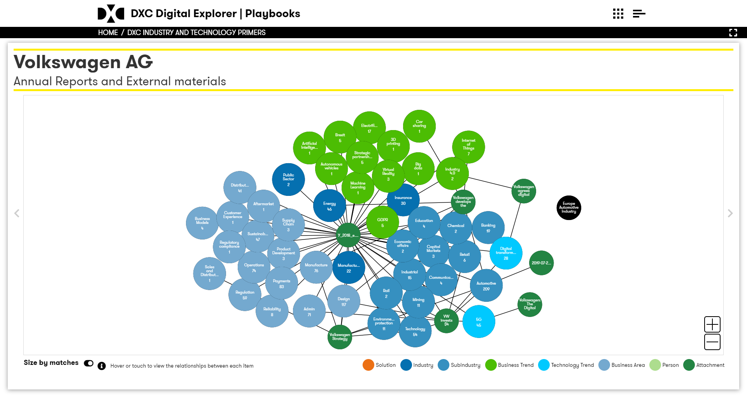
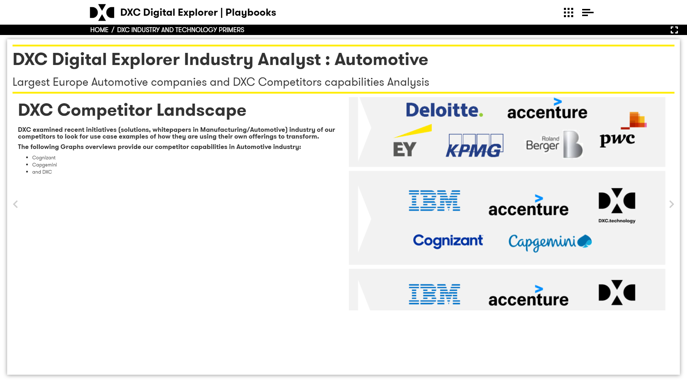
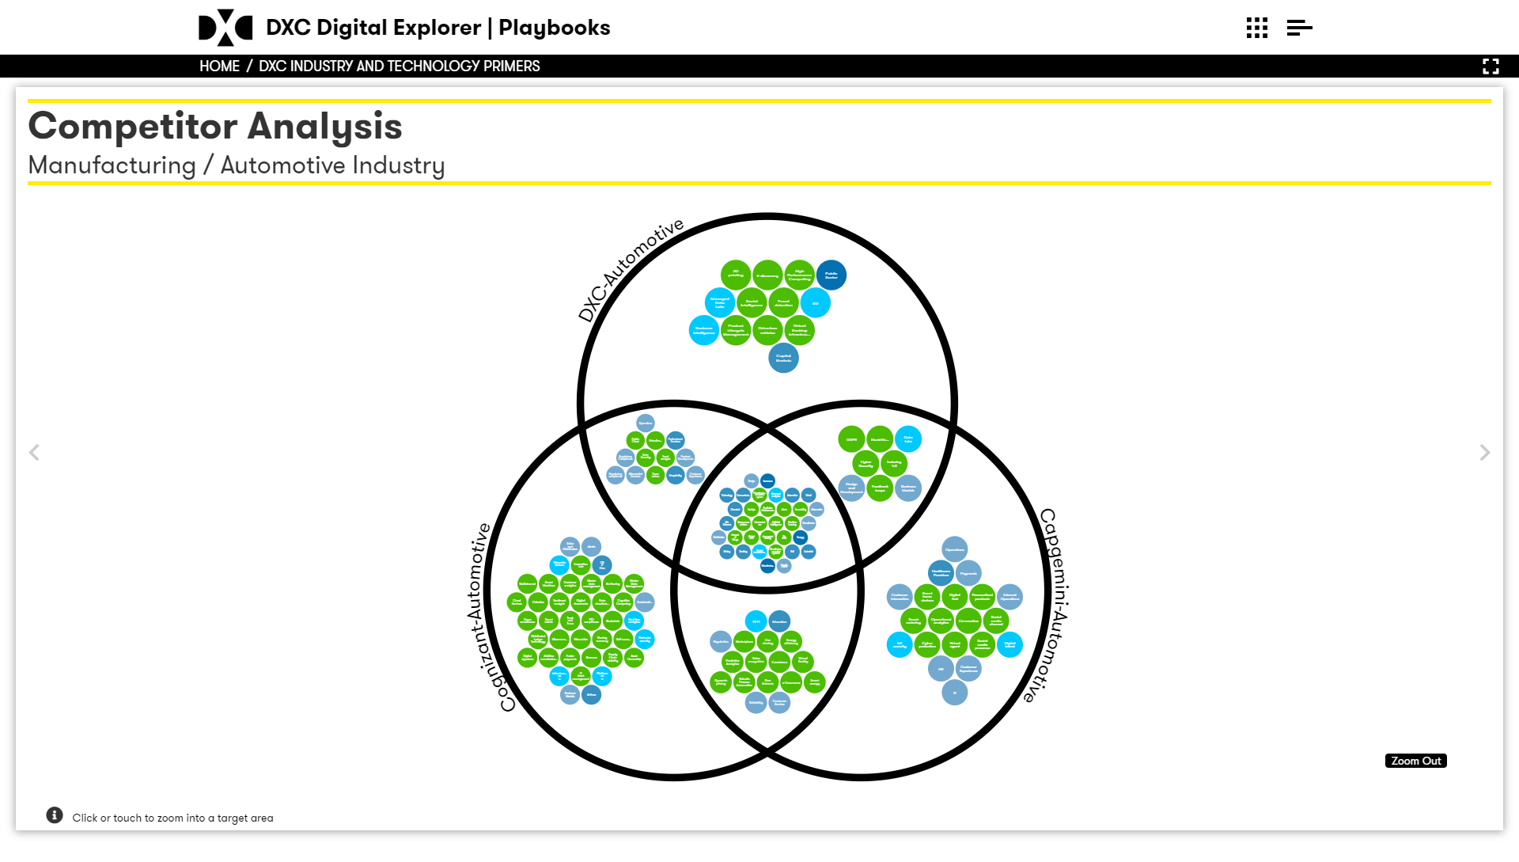
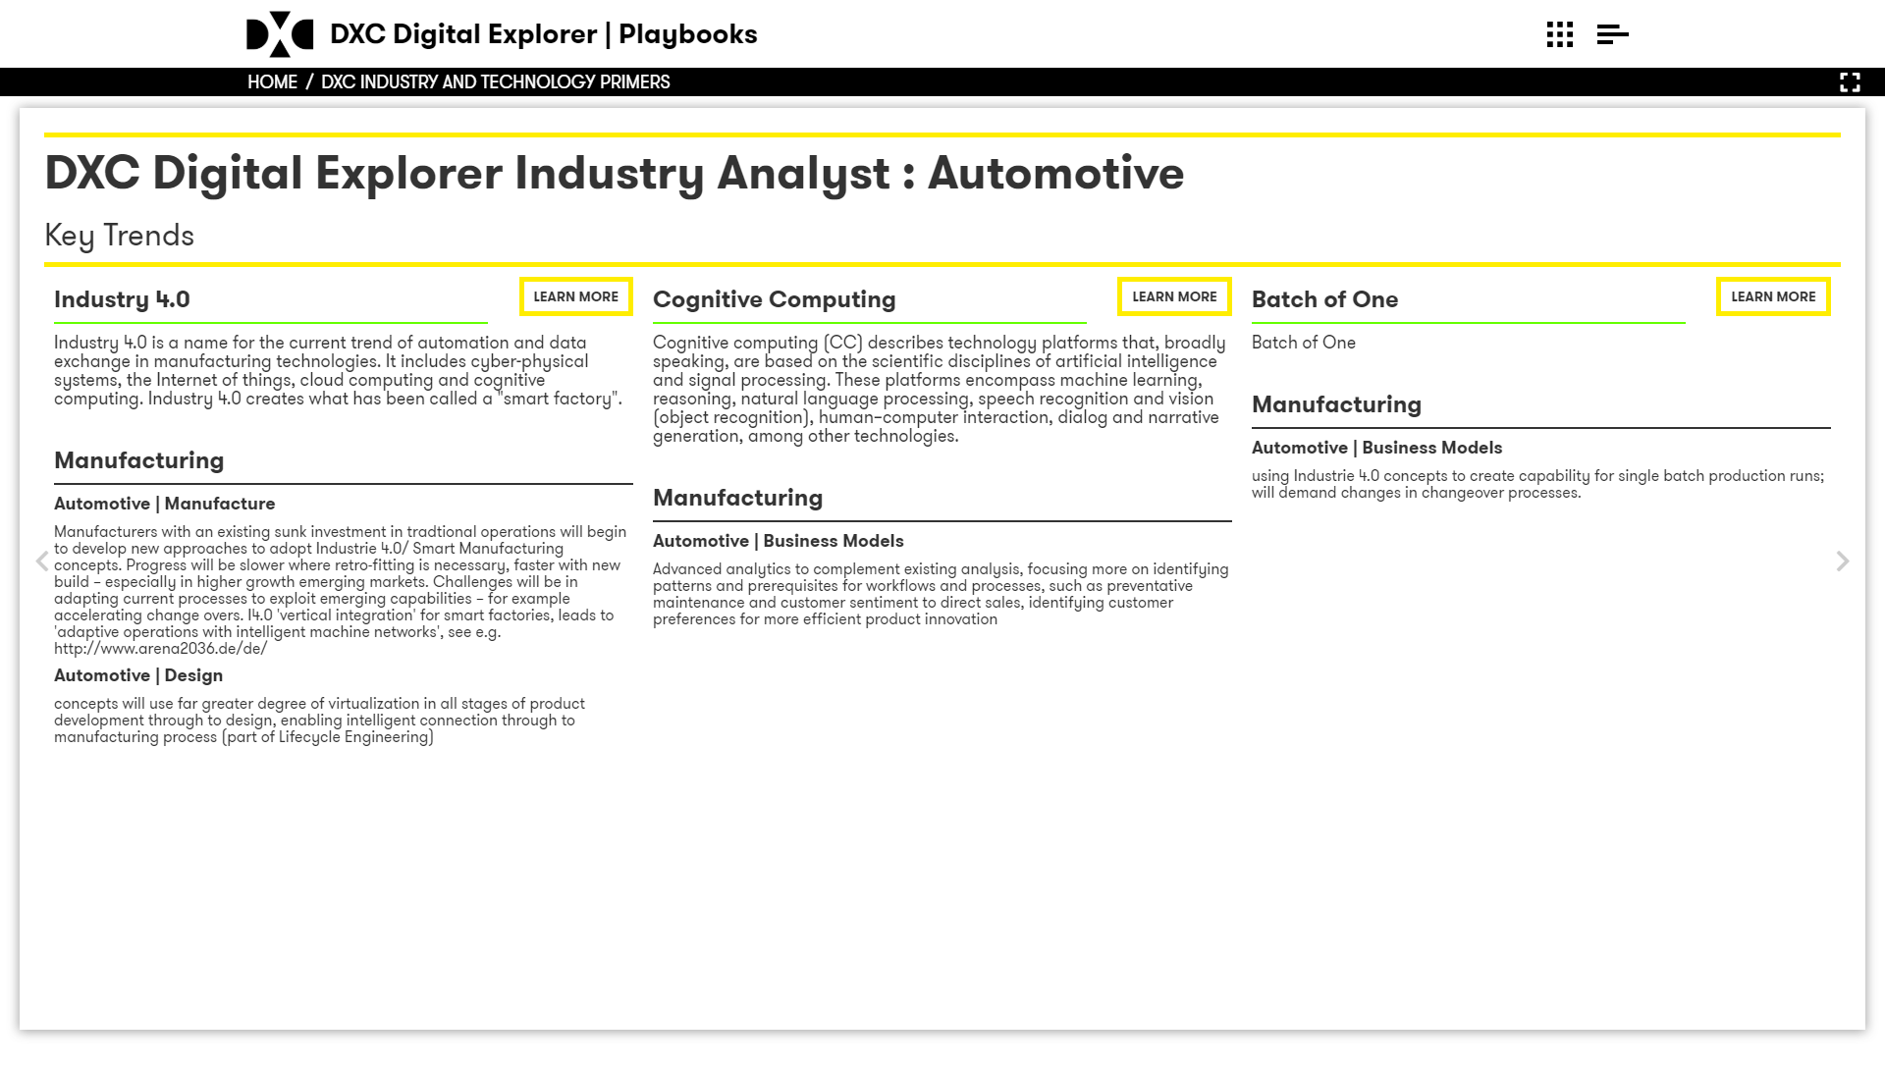
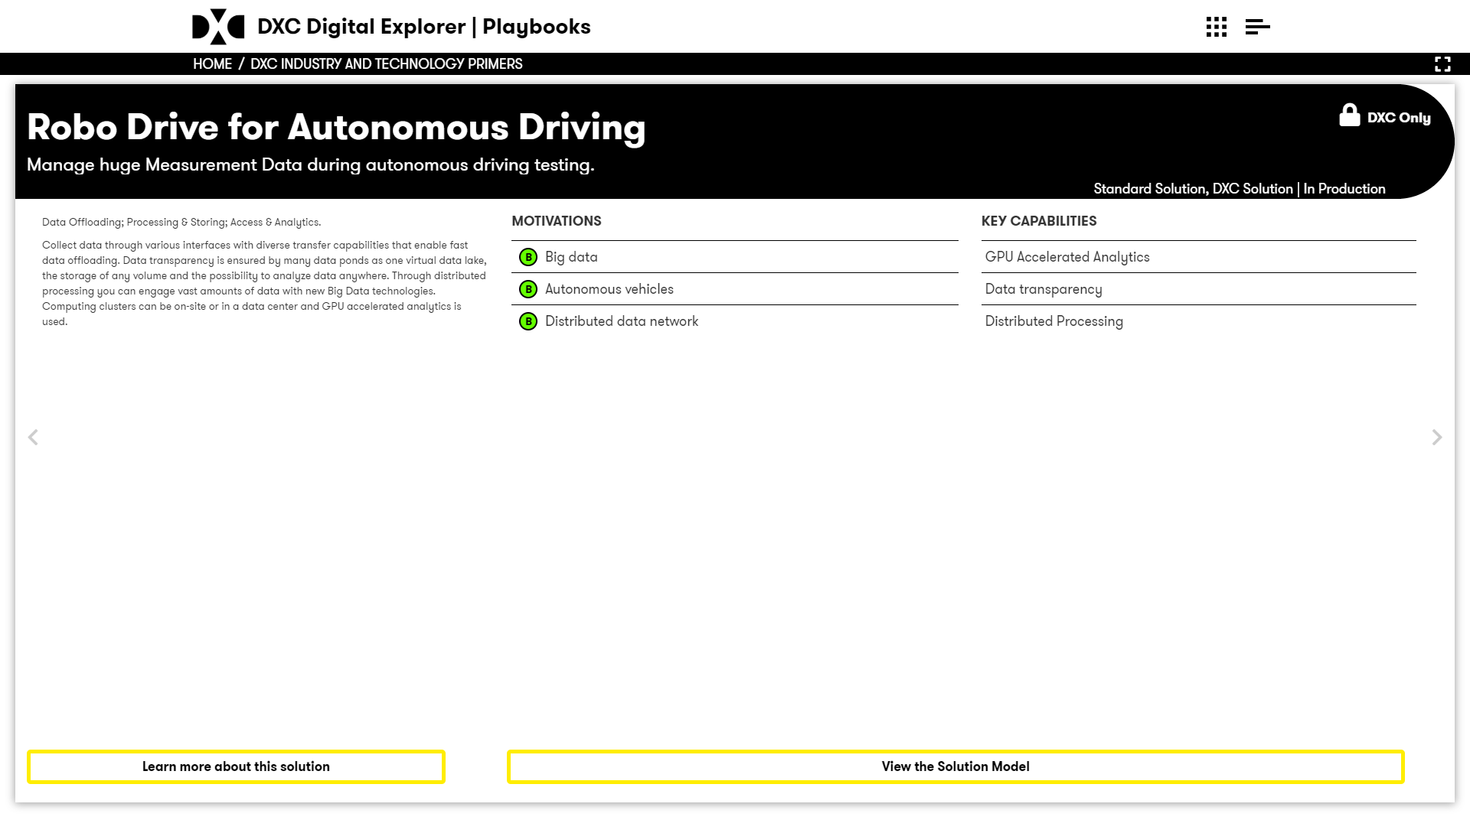
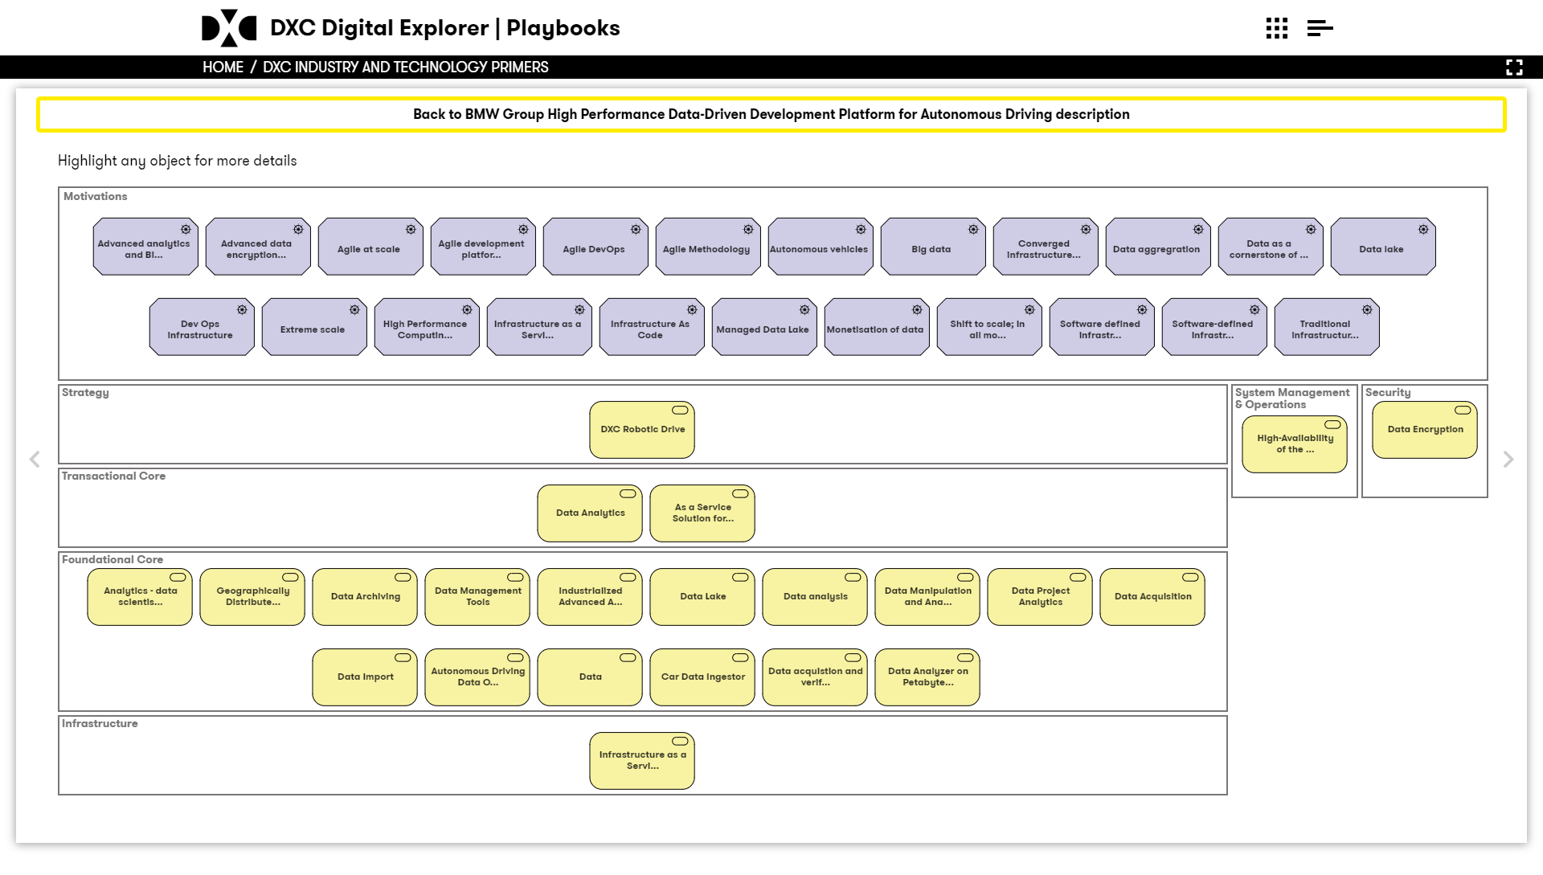
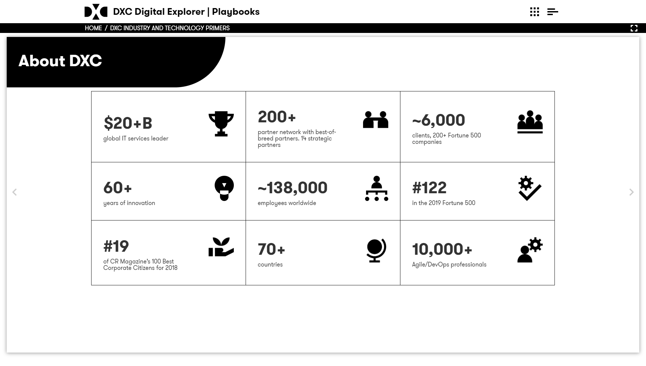

Example output https://digitalexplorer.dxc.com/pb/playbook/765453

Slide 6











Digital Explorer Achievements All team members will gain the following DE badges
Digital Trends
DE Playbooks
Workspaces
Solutions
Onboard trends
Industrialist
Optional
Thought leader
Technologist
Digital Writer
Onboard Workspaces
In the club
Onboard Solutions
Industrialist
Optional
Innovator
keep it in the family
Plus an event achievement
DXC DIGITAL EXPLORER SHAREATHON 2019

Slide 7











Sprint 1 : Trends
Sprint 2 : Markets
Sprint 3 : Solutions
Sprint 4 : Publish
Teams discuss and share thoughts on key trends within their industry
Review existing trends in Digital Explorer (descriptions, life cycle stages)
Trends should relate to the business areas DXC defines within the iBVF’s
Add/review trends into Digital Explorer
Use MS Teams and online meetings as required
Teams analyse key market material for their clients (investor reports, strategic papers)
1 Digital Explorer Workgroup per team (Team captains to set-up)
1 Digital Explorer workspace per client
Use MS Teams and online meetings as required
Single Playbook shelf to be created for the event (Dave)
Teams creates a Digital Explorer playbook to bring all their information together (see slide 4)
Playbook should cover:
Introduction and thoughts from the team (industry direction, maturity, …)
Summary of market insights (heatmaps/graph views from DE workspaces)
Key trends from week 1
Solution showcases from week 3
Team contacts
Use MS Teams and online meetings as required
Single Playbook shelf to be created for the event (Dave)
Teams creates a Digital Explorer playbook to bring all their information together (see slide 4)
Playbook should cover:
Introduction and thoughts from the team (industry direction, maturity, …)
Summary of market insights (heatmaps/graph views from DE workspaces)
Key trends from week 1
Solution showcases from week 3
Team contacts
Use MS Teams and online meetings as required
Trends
Investigate
Workspaces
Review
Create Industry Workgroup
Solutions
Client Space
Identify
Capture
Analyse
Playbooks
External Content
MS Teams

Slide 8
Post Event
Teams, plus Dave and Carrie to share and promote material across all available internal DXC channels
my.dxc.com
Workplace
Teams
Cross Industries Analyse – Dave to work with competitive intelligence team to identify common themes and create\publish a cross-industry playbook.

Slide 9
Program team
David Stevens – Program lead/Digital Explorer Support & team coach
Kimberly Gennusa ~ Sprint & team coach
Josh Merchlinksi ~ Sprint & team coach
Justin Horrell ~ Sprint & team coach
Steve Nicholls ~ Sprint & team coach
Carrie Golden – Internal comms

Slide 10
Links
Digital Explorer : https://digitalexplorer.dxc.com/
Digital Explorer issues and enhancements : https://github.dxc.com/DigitalExplorer/Digital-Explorer-Specs/issues
White belt training : https://dxc.sabacloud.com/Saba/Web_spf/NA2PRD0005/app/shared;spf-url=common%2Flearningeventdetail%2Fcurra000000000004384
Yellow belt training : https://dxc.sabacloud.com/Saba/Web_spf/NA2PRD0005/app/shared;spf-url=common%2Flearningeventdetail%2Fcurra000000000004500

Slide 11
Questions?

Slide 12
Team coaches
Week 1: Digital Trends
Pre Week1
Share the submit trends training
Week 1
Work with team captains to review/approve trends
Review and confirm the leading trends/disruptors
Industry Trends are modelled against the DXC Industry Business Value Frameworks
Industry > Sub-Industry > Business Area > Trend Use Case
https://github.com/dxc-technology/dxc-digitalexplorer/blob/master/training/Trends/ContributingTrends/readme.md

Slide 13
The trend model
Aligns to the DXC Industry Business Value Framework
Trend
Industry
Sub Industry
Value Chain / Business Area
Name & General description
Industry Use Case
Maturity

Slide 14
Team coaches
Week 2: Client Insights
Pre Week2
Create workgroup for each team (Dave)
Post Week 1 posts
Overview of new trends added
Suggestions for other teams to add to their use cases?
Week 2
Support teams with sourcing content
Keep a watch on workgroup and client names
Add client names to workgroup list
Create a workspace in your assigned group for your clients
Investor reports, Strategic papers, latest RFP
Recommendation : Complete the Digital Explorer Yellow Belt Training
Already done? Please recreate within the dedicated group for shareathon

Slide 15
Team coaches
Week 3: Solutions
Pre Week3
Share the “submit solution” training
Post Week 2 posts
Overview of workgroup insights manual process through backend
Week 3
Discuss and Review the showcase solutions to be added
Add the solution into Digital Explorer
https://github.com/dxc-technology/dxc-digitalexplorer/blob/master/training/Solutions/SubmittingSolutions/readme.md

Slide 16
Team coaches
Week 4: Playbooks
Pre Week4
Create playbook shelf (Dave)
Share the playbook creator tips
Post Week 3 input
Week 4
Support teams with editor (markdown and images)
Create a playbook to summarize the key trends, industry insights and solutions from the previous 3 weeks
https://github.com/dxc-technology/dxc-digitalexplorer/blob/master/training/Playbooks/CreatorTips.md

Slide 17

DXC Digital Explorer

